Slide 1
Prosecuting Claims Against Recovery Houses
Kolhmeyer v. Heuer House & Renewal, Inc.
(Allegheny County, GD-21-8818)
https://www.wpxi.com/news/top-stories/woman-sues-recovery-center-after-teen-daughter-allegedly-raped-by-resident/VFLDACJJMJH5NJ7YXUMTDHGEFI/

Slide 2
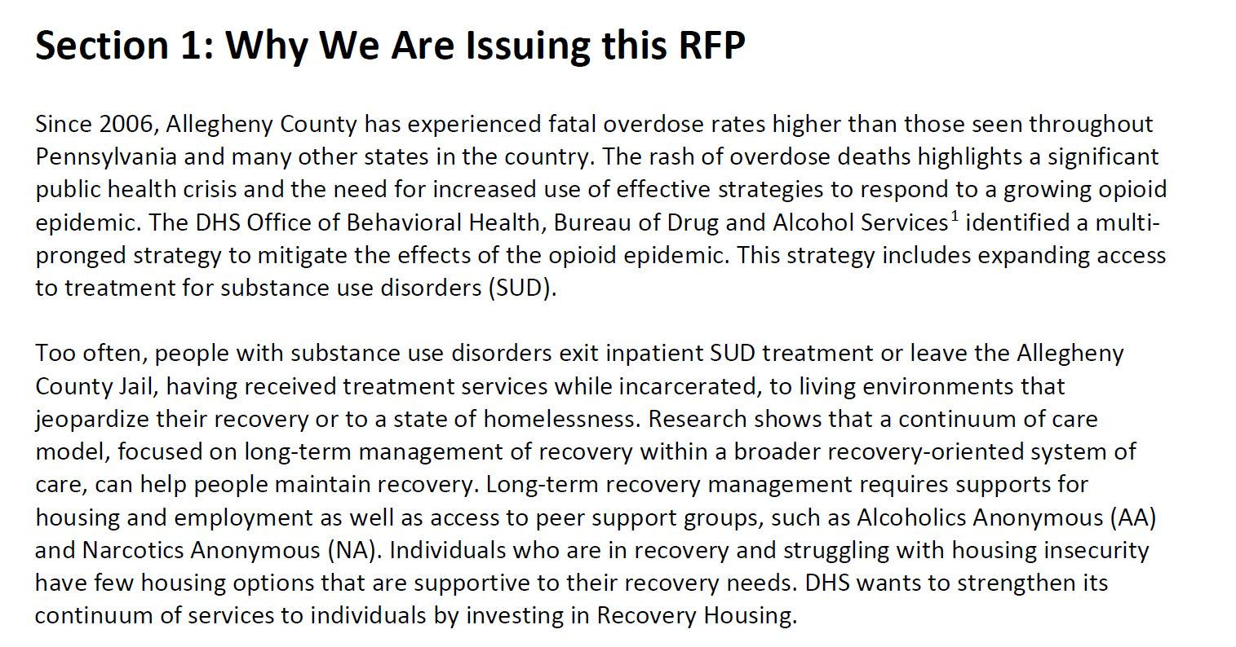
Recovery Housing in Allegheny County
New initiative (2018)
Response to the opioid epidemic

Slide 3
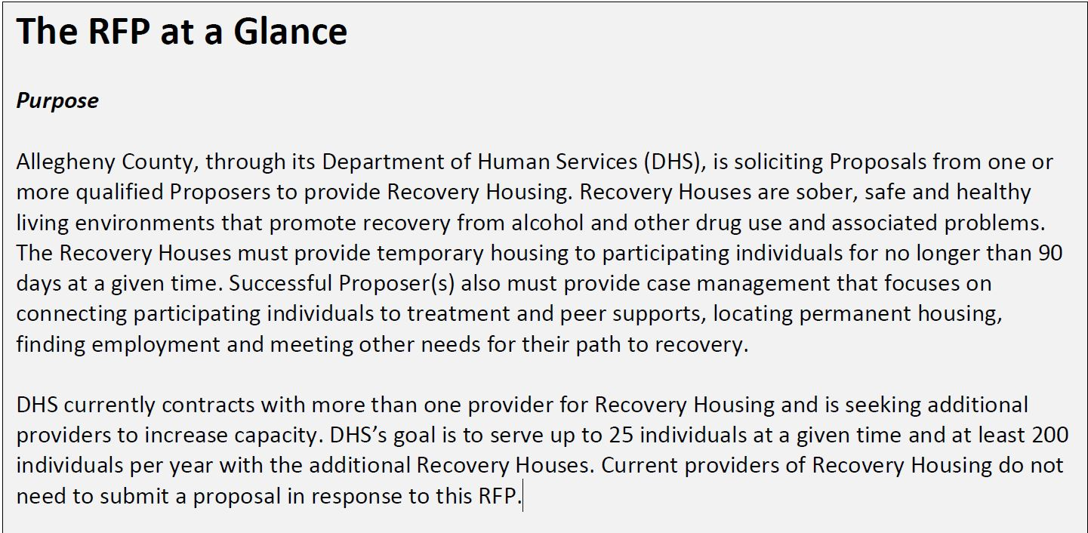
Recovery Housing in Allegheny County
Temporary housing (90 days) for people in recovery

Slide 4
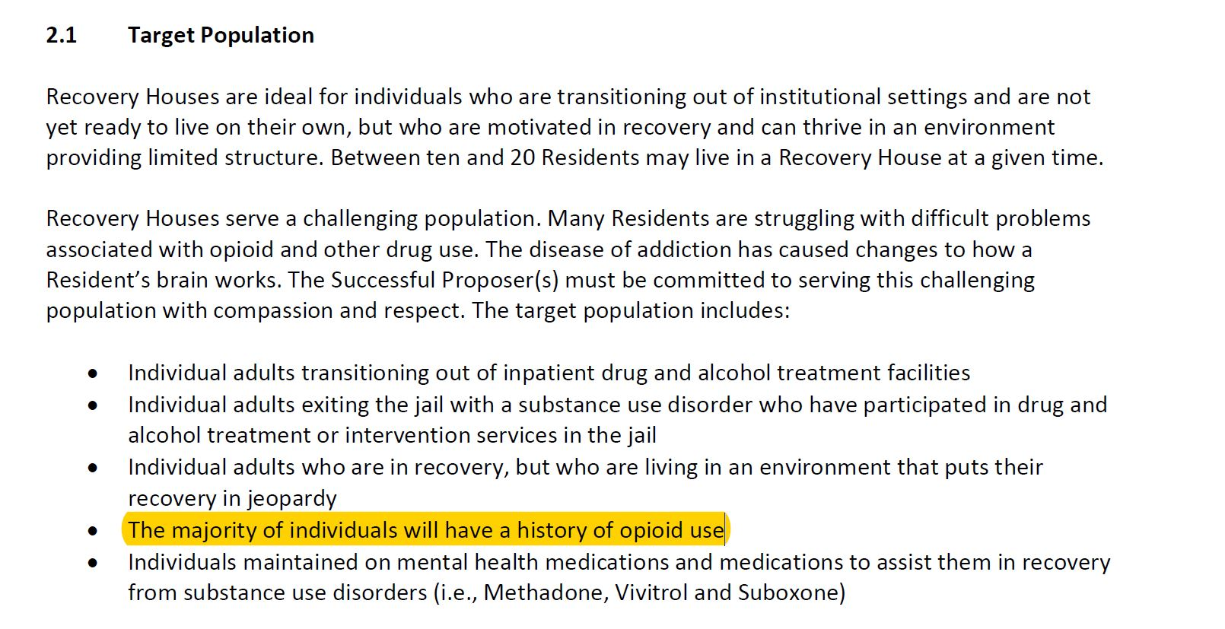
Recovery Housing Target Population – opioid users

Slide 5
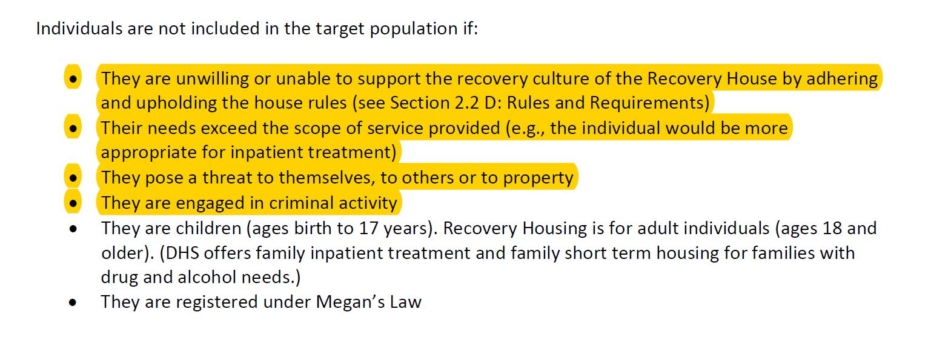
Not intended – dangerous/inpatient

Slide 6
Recovery Housing Funding/Licensing
- Both licensed and non-licensed recovery homes are permitted by regulations
  If Funded by Allegheny County Department of Human Services, then must be licensed by PA Dept. of Drug and Alcohol Programs (28 Pa. Code Chapter 717)
  Non-licensed homes ineligble for county funding
Licensed Recovery House Locator
  https://www.ddap.pa.gov/Get%20Help%20Now/Pages/Licensed-Recovery-Houses.aspx
  Allegheny County – 7 licensed Recovery Homes
  Bucks County – 10 licensed Recovery Homes
  Philadelphia County – 40+ licensed Recovery Homes

Slide 7
Requirements for Entry to Recovery Housing
Level of Care Assessment stating that resident is suitable for outpatient care
  Performed by drug and alcohol treatment providers (not recovery house itself)
  Performed in accordance with Pa. Dept. of Drug and Alcohol Programs Clinical Services Manual (see section 5.02)
Does resident meet Recovery’s House internal requirements
  Last use of drugs and alcohol
  Record of violent crimes

Slide 8
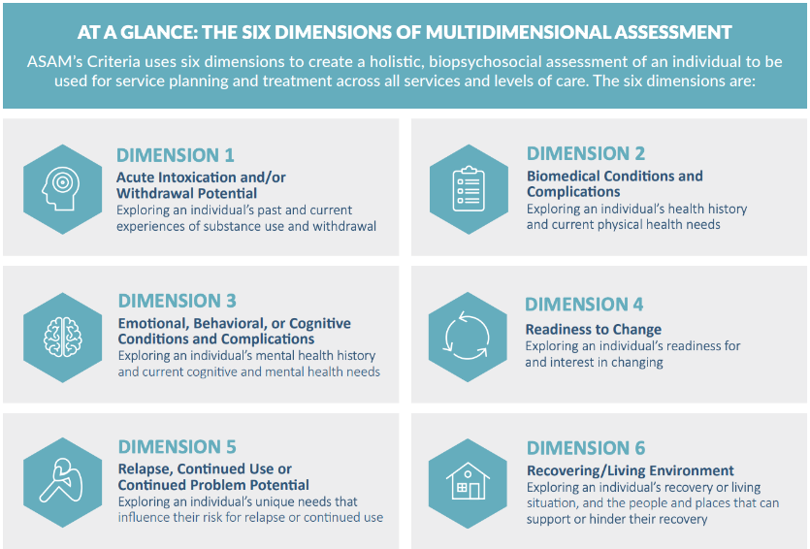
Level of Care Assessments – Six Dimensions
- Assessing Level of Care and Level of Risk across six dimensions

Slide 9
Level of Care Assessments – Risk Rating
Assessor assigns Level of Risk (0-4) in each dimension

Slide 10
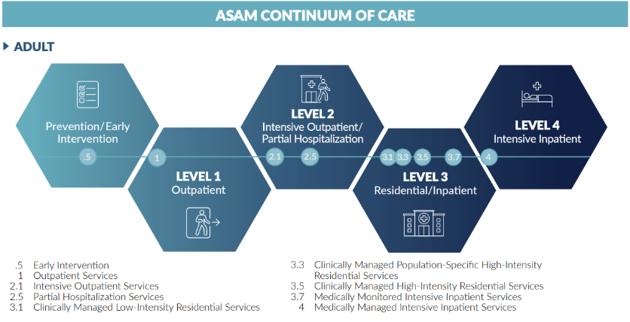
Level of Care Assessments – Treatment Recommendation
Assessor ultimately makes a Level of Care recommendation ranging from no treatment to hospitilization.

Slide 11
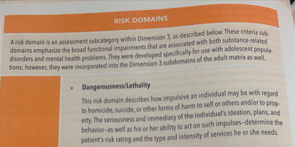
Level of Care Assessments – Dangerousness/Lethality

Slide 12
Standard of Care
Consider arrest/conviction/abuse history

Slide 13
Standard of Care
Consult collateral sources to clarify/correct history given by patient

Slide 14
Level of Care Summary Sheet

Slide 15
Prosecuting the claim
Two potential targets
  Recovery House
    Negligent security?
      Appropriate staffing
    Did patient meet the recovery House’s admission requirements
      Used alcohol in the last 28 days?
  Entity that performed LOCA (must be 2.1 or lower for recovery housing)
    Investigation – timeline of criminal and substance abuse history.
      If patient has a significant history of violent offenses, likely not suitable for recovery housing
        Depose probation officers and significant others
      If patient has a significant history of failing outpatient treatment, then likely more suitable for inpatient treatment
        Subpoena all medical records and previous treatment providers/assessors
        Depose previous assessors/recovery house supervisors

Slide 16
Prosecuting the claim – Expert Testimony
Establish Standard of Care and deviation
  Failure to consult collateral sources during assessment
  Failure to accurately assess dangerousness
  Failure to properly determine level of care needed
No licensing requirements for assesors – often performed by unlicensed drug and alcohol counselors or case managers.
If assessment is done by licensed professional (i.e., physician, psychologist), then COM.

Slide 17
Defenses
No Duty – Primary purpose of to get people treatment
Response – dangerousness/lethality is part of assessment. Purpose of assessing dangerousness is to protect the public.
Restatement 324A
One who undertakes, gratuitously or for consideration, to render services to another which he should recognize as necessary for the protection of a third person or his things, is subject to liability to the third person for physical harm resulting from his failure to exercise reasonable care to protect his undertaking, if
  his failure to exercise reasonable care increases the risk of such harm, or
  he has undertaken to perform a duty owed by the other to the third person, or
  the harm is suffered because of reliance of the other or the third person upon the undertaking.

Slide 18
Defenses
Causation – third-party criminal conduct
Response – Poor assessment created the opportunity for harm. Recovery house would not have accepted client had you done a proper assessment.

Slide 19
Shakil Hairston Timeline

